Slide 1
BIEN 401 Biomedical Mass Transport Class 17 Exam 2 Review
notes prepared by
Dr. Louis Reis
Created on 4/20/2022

Slide 2
Problem 1
A spinning disk is being proposed as a room deodorizer. The deodorizer is basically a small cylindrical disk 5 cm in diameter. One side of the disk is coated with a layer of a volatile substance that smells really good. The disk will rotate at 300 RPM, and the average room temperature is 20ºC. The saturation concentration of the volatile substance in air at these conditions is 3 x 10⁻⁸ mol/cm³, and the diffusivity of the volatile substance in air is 0.06 cm²/s. The kinematic viscosity of the air is 0.151 cm²/s. The volatile substance has a density of 1.1 g/cm³ and a molecular weight of 173 g/mol.
Estimate how long it will take for the average thickness of the volatile substance layer to decrease by 1 mm.

Slide 3
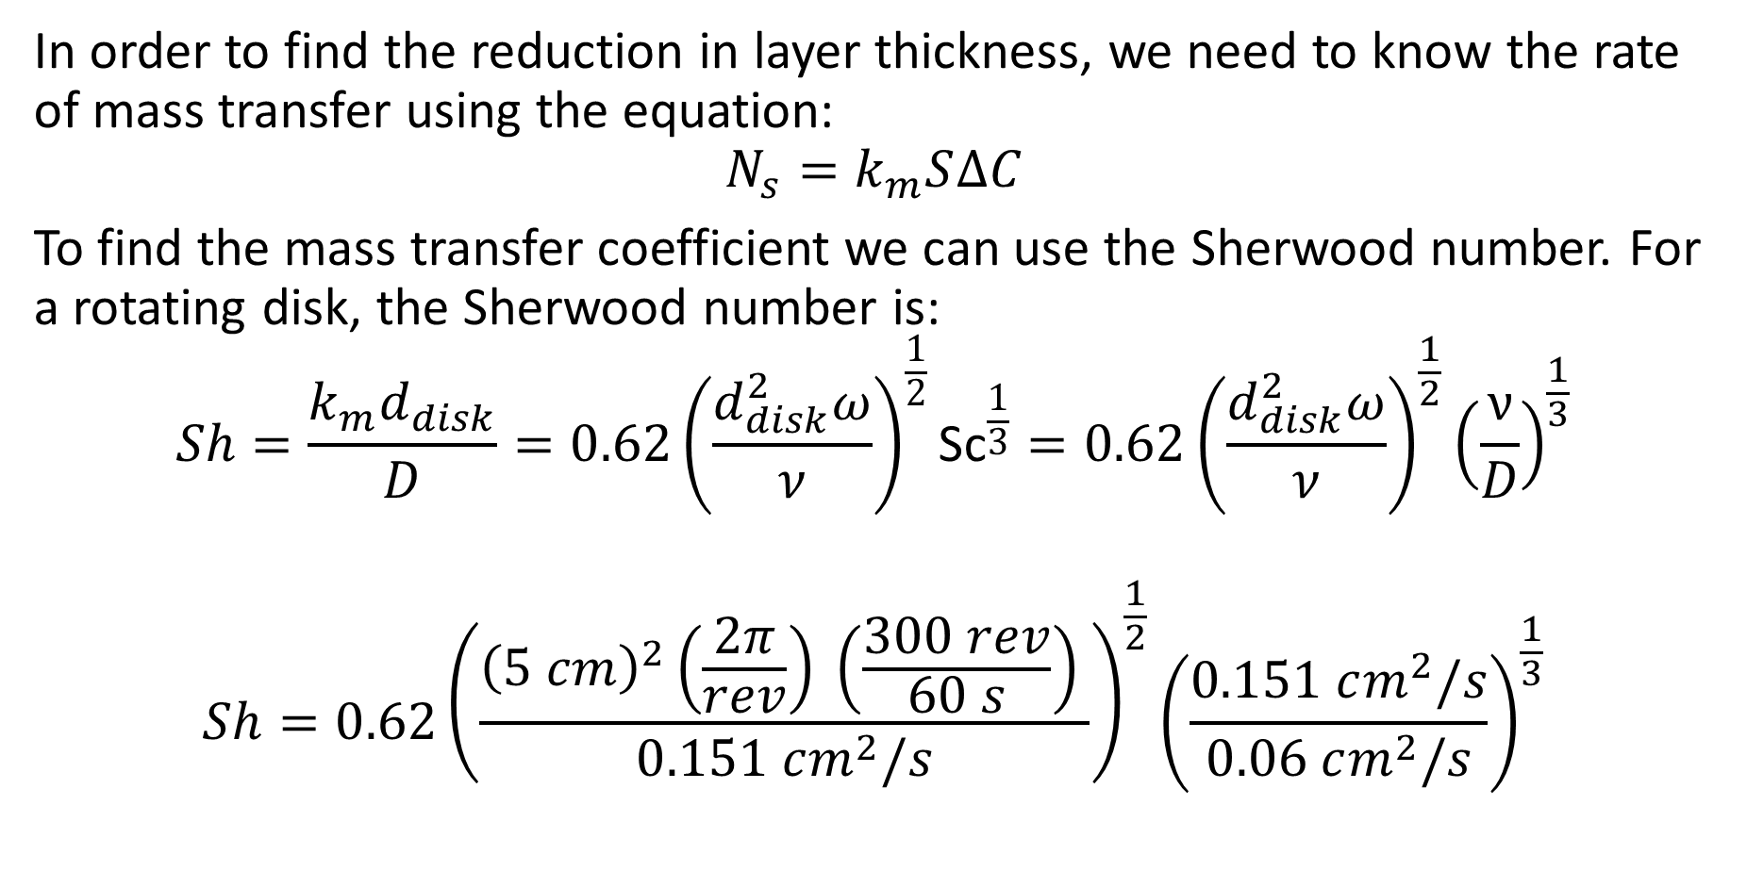
Problem 1 Solution
In order to find the reduction in layer thickness, we need to know the rate of mass transfer using the equation:
$$N_{s}=k_{m}S∆C$$
To find the mass transfer coefficient we can use the Sherwood number. For a rotating disk, the Sherwood number is:
$$Sh=\frac{k_{m}d_{disk}}{D}=0.62{\left(\frac{d_{disk}^{2}ω}{ν}\right)}^{\frac{1}{2}}{\text{Sc}}^{\frac{1}{3}}=0.62{\left(\frac{d_{disk}^{2}ω}{ν}\right)}^{\frac{1}{2}}{\left(\frac{ν}{D}\right)}^{\frac{1}{3}}$$
$$Sh=0.62{\left(\frac{{\left(5 cm\right)}^{2}\left(\frac{2π}{rev}\right) \left(\frac{300 rev}{60 s}\right) }{0.151 cm^{2}/s}\right)}^{\frac{1}{2}}{\left(\frac{0.151 cm^{2}/s}{0.06 cm^{2}/s}\right)}^{\frac{1}{3}}$$

Slide 4
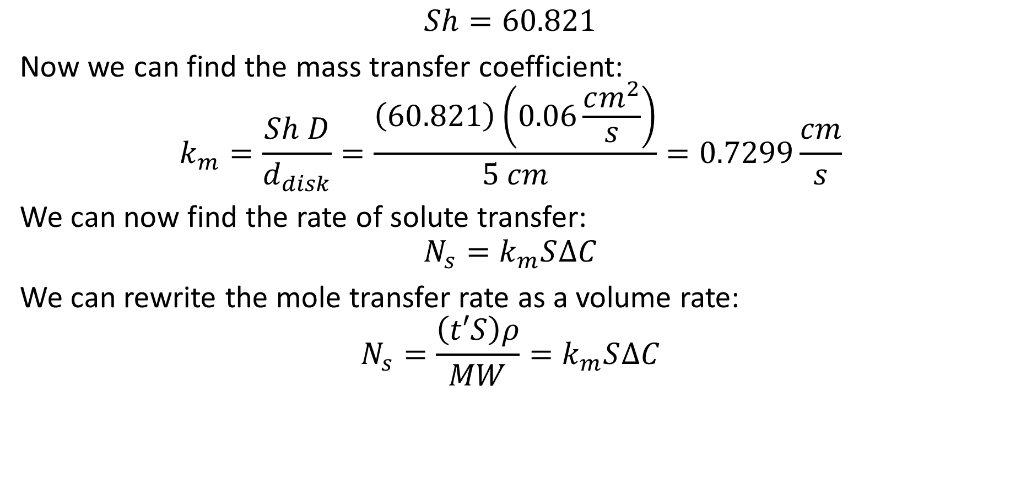
Problem 1 Solution
$$Sh=60.821$$
Now we can find the mass transfer coefficient:
$$k_{m}=\frac{Sh D}{d_{disk}}=\frac{\left(60.821\right)\left(0.06\frac{cm^{2}}{s}\right)}{5 cm}=0.7299\frac{cm}{s}$$
We can now find the rate of solute transfer:
$$N_{s}=k_{m}S∆C$$
We can rewrite the mole transfer rate as a volume rate:
$$N_{s}=\frac{\left(t′S\right)ρ}{MW}=k_{m}S∆C$$

Slide 5
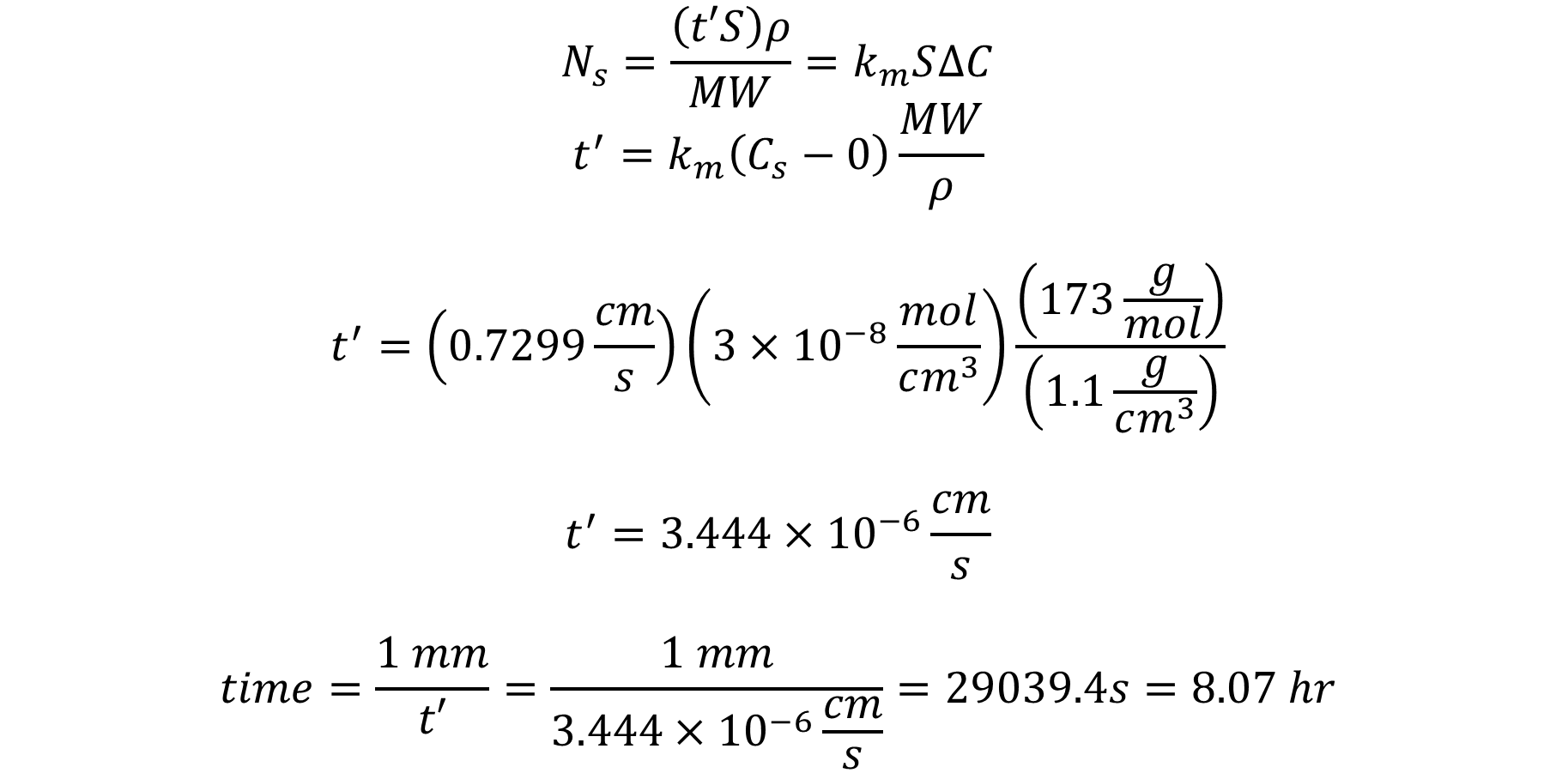
Problem 1 Solution
$$N_{s}=\frac{\left(t′S\right)ρ}{MW}=k_{m}S∆C$$
$$t^{′}=k_{m}\left(C_{s}−0\right)\frac{MW}{ρ}$$
$$t^{′}=\left(0.7299\frac{cm}{s}\right)\left(3×{10}^{−8}\frac{mol}{cm^{3}}\right)\frac{\left(173\frac{g}{mol}\right)}{\left(1.1\frac{g}{cm^{3}}\right)}$$
$$t^{′}=3.444×{10}^{−6}\frac{cm}{s}$$
$$time=\frac{1 mm}{t′}=\frac{1 mm}{3.444×{10}^{−6}\frac{cm}{s}}=29039.4s=8.07 hr$$

Slide 6
Problem 2
A well-mixed protein solution is being filtered across a semipermeable membrane. The pores in the membrane have an average radius of 3.6 nm, and the radius of the protein molecule is 2.2 nm. The protein concentration in the bulk solution of 1.5 g/L. The protein’s mass transfer coefficient is 3.5 x 10⁻⁴ cm/s, and the filtration flux of the protein solution across the membrane is 1.5 x 10⁻⁴ cm/s. Determine the concentration of the protein in the filtrate solution.

Slide 7
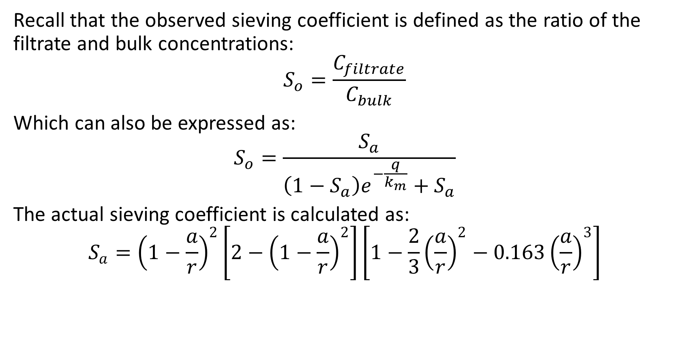
Problem 2 Solution
Recall that the observed sieving coefficient is defined as the ratio of the filtrate and bulk concentrations:
$$S_{o}=\frac{C_{filtrate}}{C_{bulk}}$$
Which can also be expressed as:
$$S_{o}=\frac{S_{a}}{\left(1−S_{a}\right)e^{−\frac{q}{k_{m}}}+S_{a}}$$
The actual sieving coefficient is calculated as:
$$S_{a}={\left(1−\frac{a}{r}\right)}^{2}\left[2−{\left(1−\frac{a}{r}\right)}^{2}\right]\left[1−\frac{2}{3}{\left(\frac{a}{r}\right)}^{2}−0.163{\left(\frac{a}{r}\right)}^{3}\right]$$

Slide 8
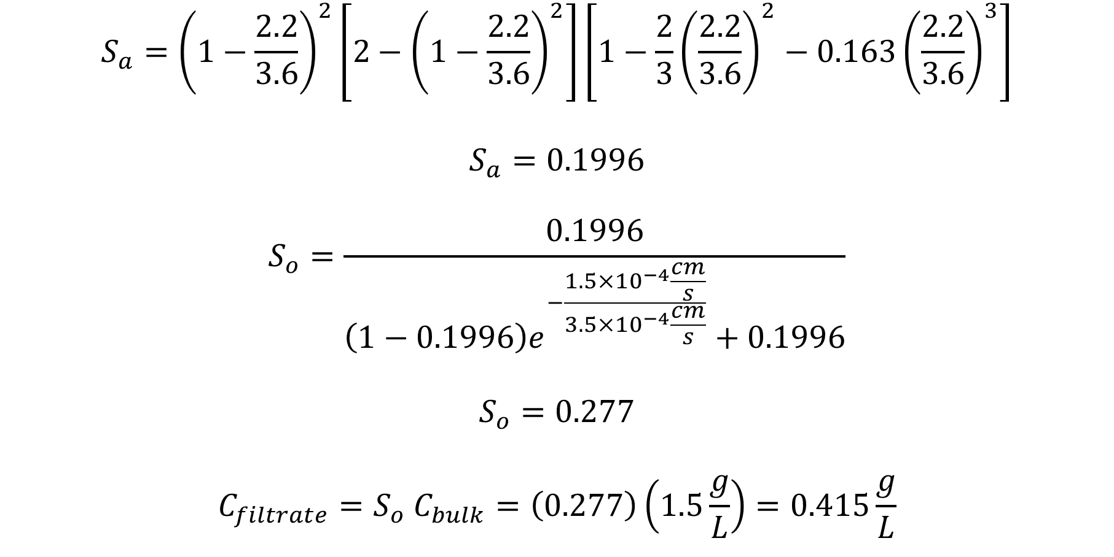
Problem 2 Solution
$$S_{a}={\left(1−\frac{2.2}{3.6}\right)}^{2}\left[2−{\left(1−\frac{2.2}{3.6}\right)}^{2}\right]\left[1−\frac{2}{3}{\left(\frac{2.2}{3.6}\right)}^{2}−0.163{\left(\frac{2.2}{3.6}\right)}^{3}\right]$$
$$S_{a}=0.1996$$
$$S_{o}=\frac{0.1996}{\left(1−0.1996\right)e^{−\frac{1.5×{10}^{−4}\frac{cm}{s}}{3.5×{10}^{−4}\frac{cm}{s}}}+0.1996}$$
$$S_{o}=0.277$$
$$C_{filtrate}=S_{o} C_{bulk}=\left(0.277\right)\left(1.5\frac{g}{L}\right)=0.415\frac{g}{L}$$

Slide 9
Problem 3
Determine the membrane permeability for a spherically shaped molecule with a molecular weight of 35 kDa through a membrane with straight cylindrical pores that are 8 nm in diameter. The porosity of the membrane is 0.4 and the thickness of the membrane is 40 μm. Assume the fluid is water at 37ºC.

Slide 10
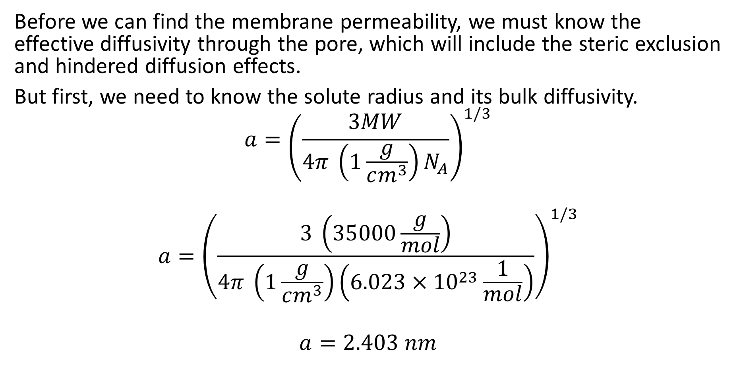
Problem 3 Solution
Before we can find the membrane permeability, we must know the effective diffusivity through the pore, which will include the steric exclusion and hindered diffusion effects.
But first, we need to know the solute radius and its bulk diffusivity.
$$a={\left(\frac{3MW}{4π \left(1\frac{g}{cm^{3}}\right)N_{A}}\right)}^{1/3}$$
$$a={\left(\frac{3 \left(35000\frac{g}{mol}\right)}{4π \left(1\frac{g}{cm^{3}}\right)\left(6.023×{10}^{23}\frac{1}{mol}\right)}\right)}^{1/3}$$
$$a=2.403 nm$$

Slide 11
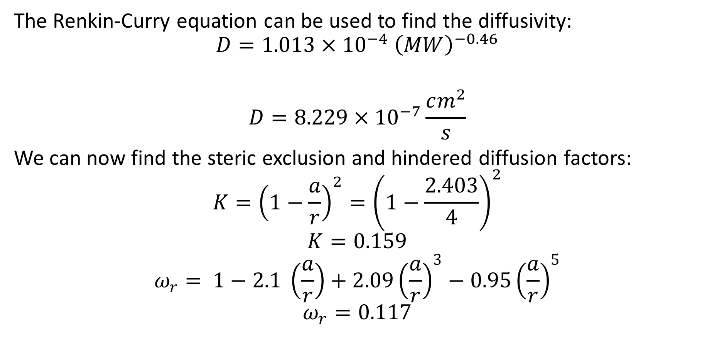
Problem 3 Solution
The Renkin-Curry equation can be used to find the diffusivity:
$$D=1.013×{10}^{−4} {\left(MW\right)}^{−0.46}$$
$$D=8.229×{10}^{−7}\frac{cm^{2}}{s}$$
We can now find the steric exclusion and hindered diffusion factors:
$$K={\left(1−\frac{a}{r}\right)}^{2}={\left(1−\frac{2.403}{4}\right)}^{2}$$
$$K=0.159$$
$$ω_{r}= 1−2.1 \left(\frac{a}{r}\right)+2.09{\left(\frac{a}{r}\right)}^{3}−0.95{\left(\frac{a}{r}\right)}^{5}$$
$$ω_{r}=0.117$$

Slide 12
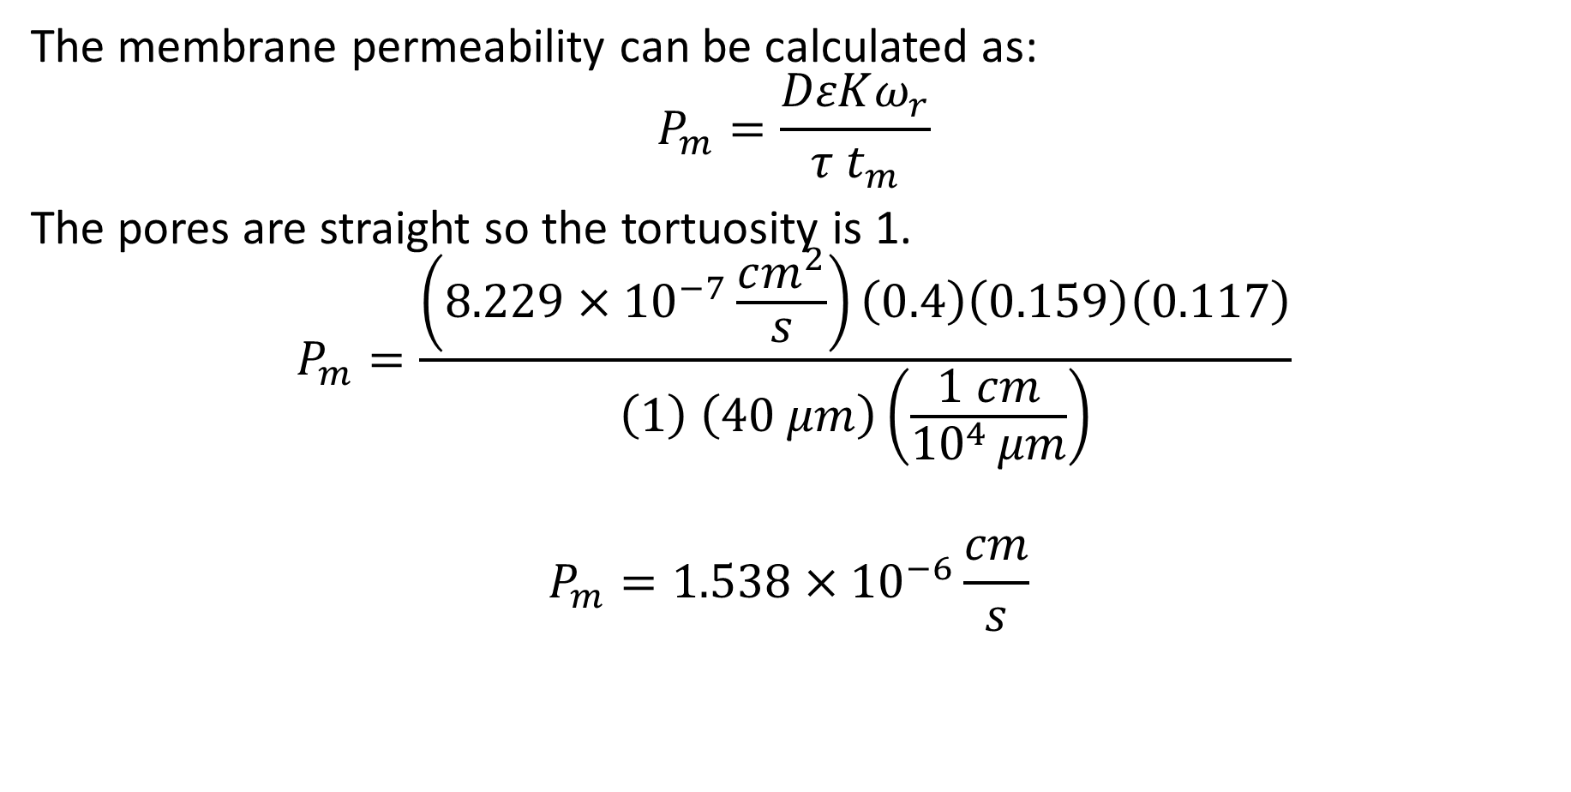
Problem 3 Solution
The membrane permeability can be calculated as:
$$P_{m}=\frac{DεKω_{r}}{τ t_{m}}$$
The pores are straight so the tortuosity is 1.
$$P_{m}=\frac{\left(8.229×{10}^{−7}\frac{cm^{2}}{s}\right)\left(0.4\right)\left(0.159\right)\left(0.117\right)}{\left(1\right) \left(40 μm\right)\left(\frac{1 cm}{{10}^{4 }μm}\right)}$$
$$P_{m}=1.538×{10}^{−6}\frac{cm}{s}$$

Slide 13
Problem 4
Consider the oxygen transport within a flat disk-shaped tumor of total thickness 250 μm. The surfaces of the tumor are covered with capillaries such that the oxygen concentration at the surface of the tumor is equal to 120 μM. A microelectrode placed at the center of the tumor is 15 mmHg, and a tissue sample indicated that the volume fraction of the tumor cells was equal to 0.45. Assume the Henry constant is 0.74 mmHg/μM. The diffusivity of oxygen in the tumor can be assumed to be 1.67 x 10⁻⁵ cm²/s. Determine the oxygen consumption rate of the tumor cells.

Slide 14
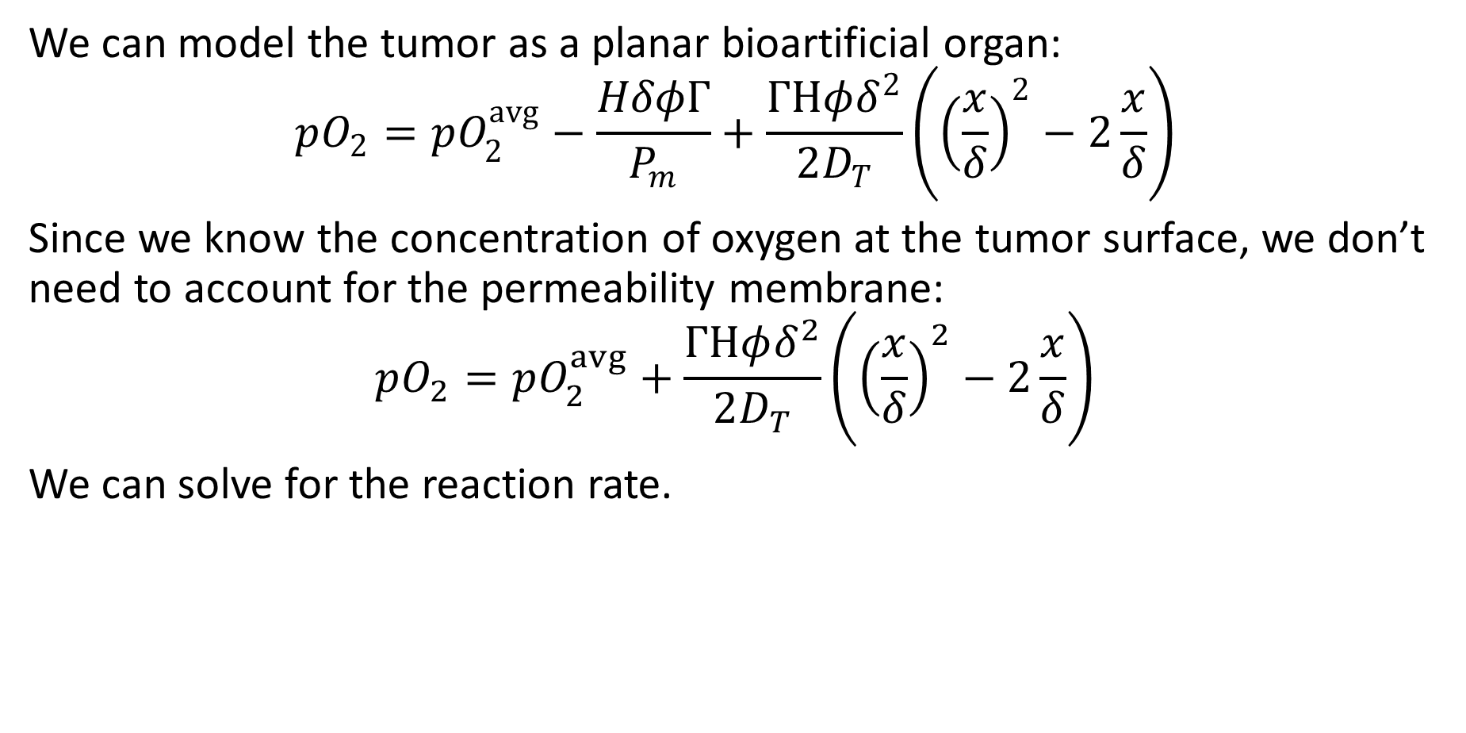
Problem 4 Solution
We can model the tumor as a planar bioartificial organ:
$$pO_{2}=pO_{2}^{avg}−\frac{HδφΓ}{P_{m}}+\frac{ΓHφδ^{2}}{2D_{T}}\left({\left(\frac{x}{δ}\right)}^{2}−2\frac{x}{δ}\right)$$
Since we know the concentration of oxygen at the tumor surface, we don’t need to account for the permeability membrane:
$$pO_{2}=pO_{2}^{avg}+\frac{ΓHφδ^{2}}{2D_{T}}\left({\left(\frac{x}{δ}\right)}^{2}−2\frac{x}{δ}\right)$$
We can solve for the reaction rate.

Slide 15
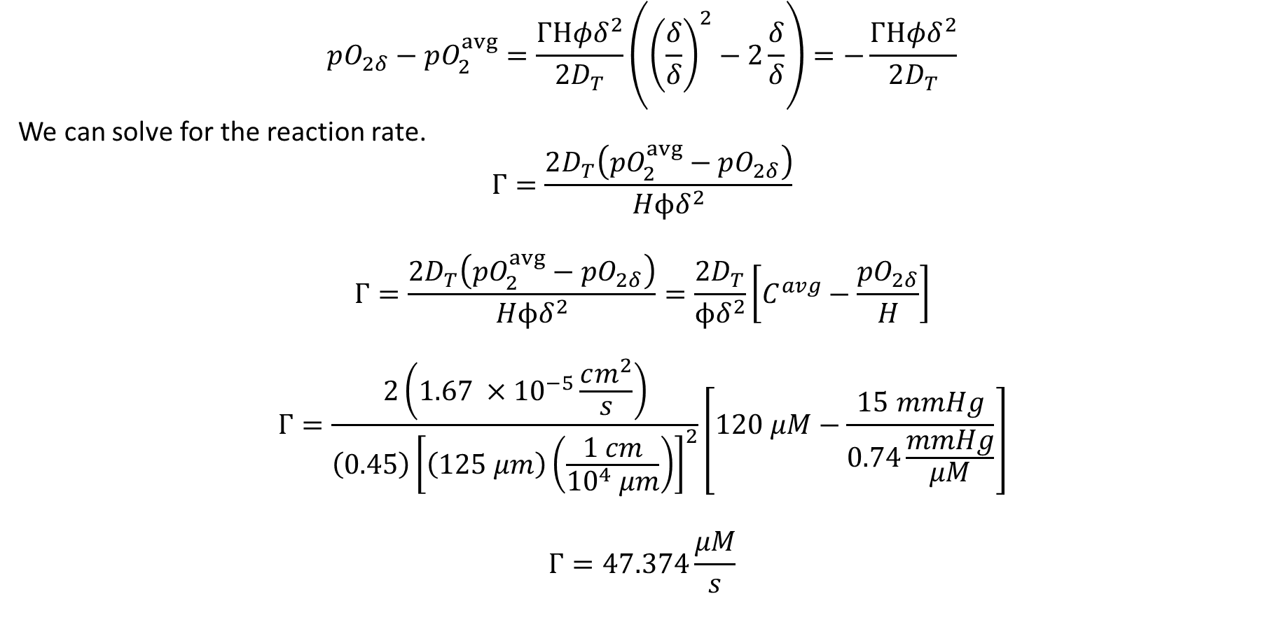
Problem 4 Solution
$$pO_{2δ}−pO_{2}^{avg}=\frac{ΓHφδ^{2}}{2D_{T}}\left({\left(\frac{δ}{δ}\right)}^{2}−2\frac{δ}{δ}\right)=−\frac{ΓHφδ^{2}}{2D_{T}}$$
We can solve for the reaction rate.
$$Γ=\frac{2D_{T}\left(pO_{2}^{avg}−pO_{2δ}\right)}{Hϕδ^{2}}$$
$$Γ=\frac{2D_{T}\left(pO_{2}^{avg}−pO_{2δ}\right)}{Hϕδ^{2}}=\frac{2D_{T}}{ϕδ^{2}}\left[C^{avg}−\frac{pO_{2δ}}{H}\right]$$
$$Γ=\frac{2\left(1.67 ×{10}^{−5}\frac{cm^{2}}{s}\right)}{\left(0.45\right){\left[\left(125 μm\right)\left(\frac{1 cm}{{10}^{4} μm}\right)\right]}^{2}}\left[120 μM−\frac{15 mmHg}{0.74\frac{mmHg}{μM}}\right]$$
$$Γ=47.374\frac{μM}{s}$$

Slide 16






Problem 5
Consider the two-compartment model shown below. Write out the material balances for the two compartments assuming the drug is administered as a bolus injection.
$$k_{21}$$
$$C_{1}$$
$$V_{1}$$
$$C_{2}$$
$$V_{2}$$
drug
$$k_{12}$$
$$k_{e1}$$
$$k_{e2}$$

Slide 17
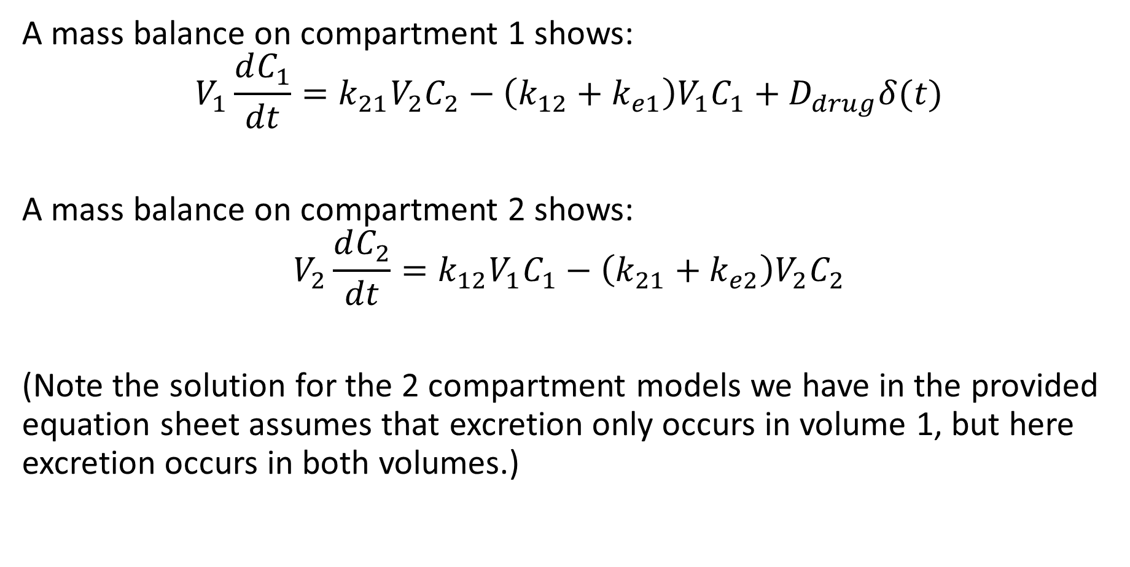
Problem 5 Solution
A mass balance on compartment 1 shows:
$$V_{1}\frac{dC_{1}}{dt}=k_{21}V_{2}C_{2}−\left(k_{12}+k_{e1}\right)V_{1}C_{1}+D_{drug}δ(t)$$
A mass balance on compartment 2 shows:
$$V_{2}\frac{dC_{2}}{dt}=k_{12}V_{1}C_{1}−\left(k_{21}+k_{e2}\right)V_{2}C_{2}$$
(Note the solution for the 2 compartment models we have in the provided equation sheet assumes that excretion only occurs in volume 1, but here excretion occurs in both volumes.)

